Slide 1



Lessons Learned from the First 20 Months of Implementing School Improvement Grants (SIG)
Featuring:
Mark Coscarella, Michigan Department of Education
Mary Colvin and Gina Scroggins, Oklahoma State Department of Education
Brian Staples, Frederick A. Douglass High & Middle School, Oklahoma City
Sam Redding, CII

Slide 2
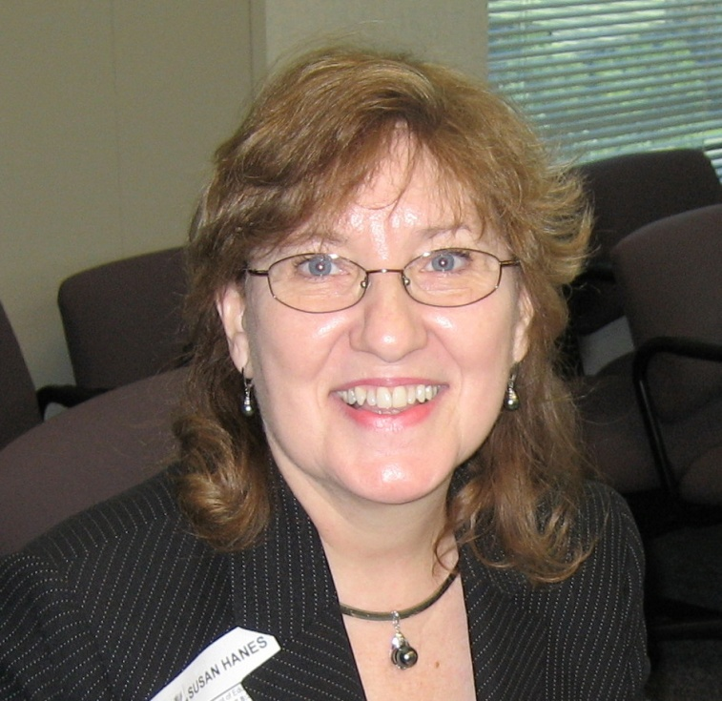
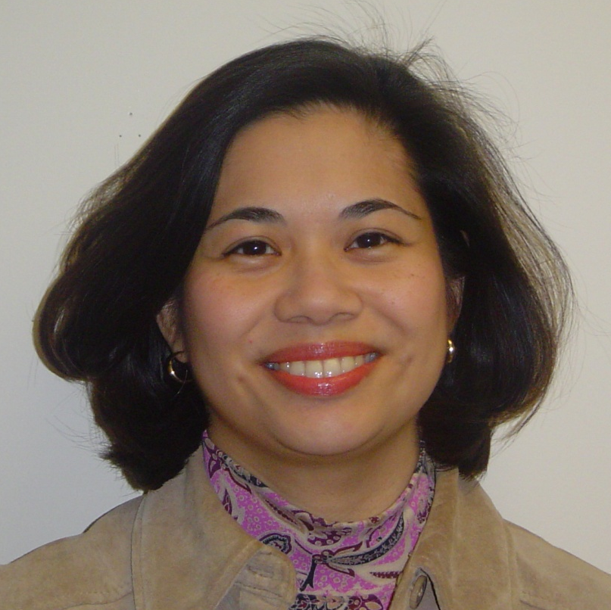
NNSSIL Co-coordinators
Susan Hanes
Technical Advisor, Center on Innovation and Improvement
Nina de las Alas
Senior Program Associate, Council of Chief State School Officers
Notes:
2

Slide 3
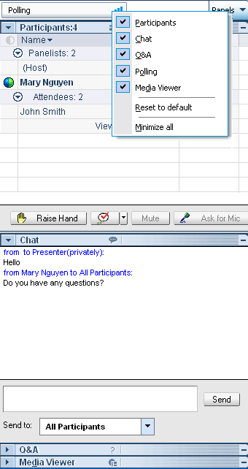
WebEx Panels & Features
Participants
Raise/lower hand
Chat
Q&A
Notes:
3

Slide 4
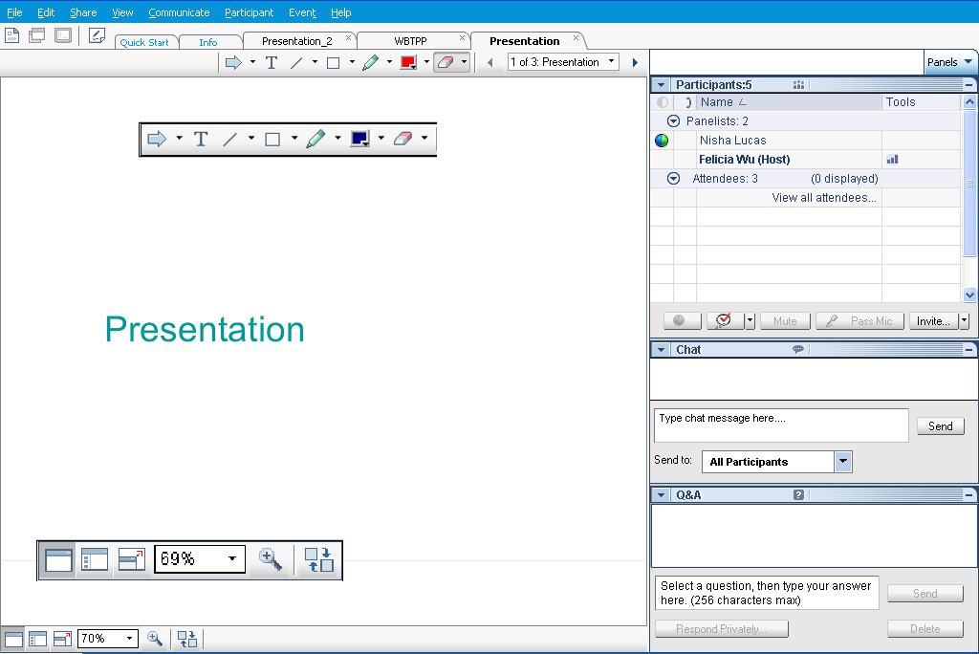
Webex Panels & Features
Presentations
Visual magnification
Audio volume (manual control through your phone or if using VOIP through computer’s audio controls . If you still cannot hear, please send Nina a chat message) or contact WebEx Tech Support (866-229-3239).
Notes:
4

Slide 5
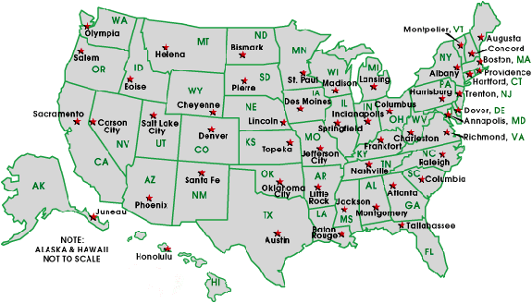
National Network of State School Improvement Leaders (NNSSIL)
Membership
50+ SEAs and territories
16 Regional Comprehensive
Centers (RCCs) & 5 Content
Centers
Advisory Group – Design Team
Subgroup of state reps., sub-dir.-level RCC
staffers, US ED, and NNSSIL co-coordinators
Administrative Partners
Center on Innovation & Improvement
Council of Chief State School Officers
More information: http://www.centerii.org/leaders

Slide 6
Lessons Learned from Implementing SIG program
Purpose
Present findings from CII’s Fulcrum of Change Report
Revisit to two states featured in the report—Michigan and Oklahoma—to taking a closer look at how they mobilized their strategies, resources and supports to turn around their lowest-performing schools
  Share data that document changes in the way state, district, school, and technical provider staff are doing business
  Provide insights into the successes
  Share their continued concerns, issues and challenges, and
  Discuss how they have applied what was learned
Field questions from participants

Slide 7
Featured Presenters

Slide 8
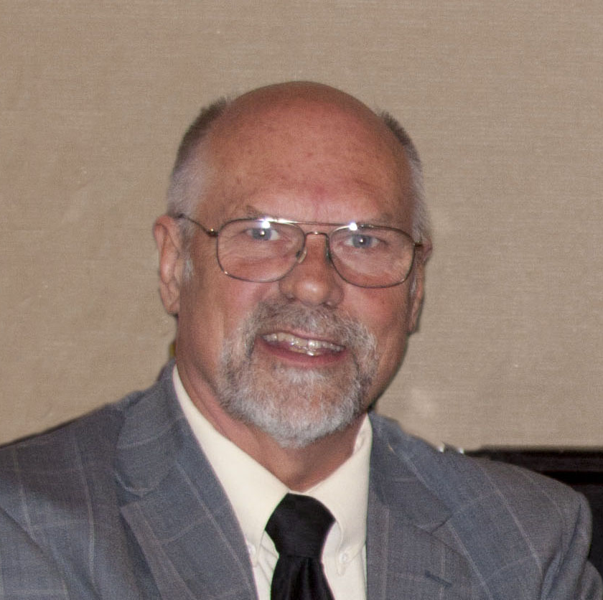
Featured Presenters
Sam Redding
Director, CII
Co-Author, Fulcrum of Change: Leveraging 50 States to Turn Around 5,000 Schools

Slide 9
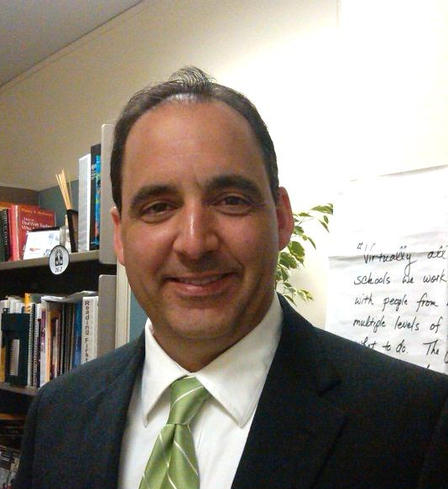
Featured Presenters
Mark Coscarella
Assistant Director, Office of Education Improvement and Innovation (OEII)
Michigan Department of Education

Slide 10
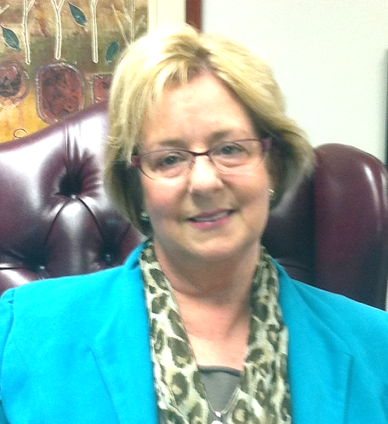
Featured Presenters
Mary Colvin
Executive Director,
School Support/School Improvement
Oklahoma State Department of Education

Slide 11
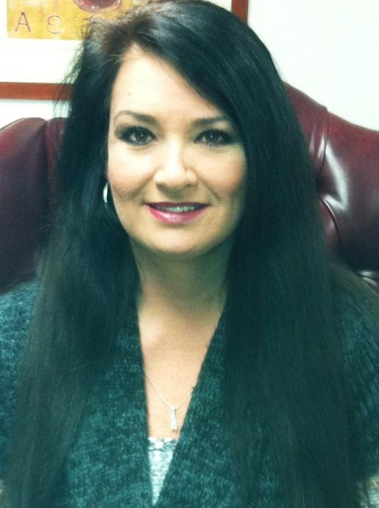
Featured Presenters
Gina Scroggins
Director, SIG Turnaround Schools
Oklahoma State Department of Education

Slide 12
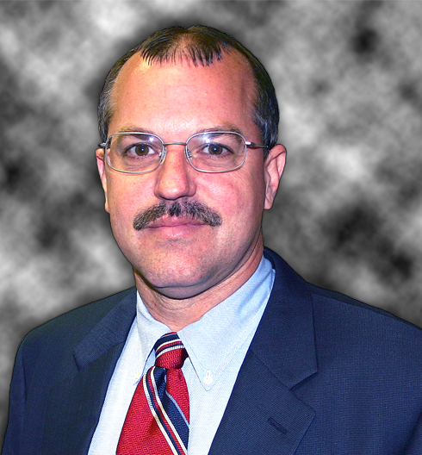
Featured Presenters
Brian Staples
Principal,
Frederick A. Douglass High School and Middle School
Oklahoma City Public Schools

Slide 13
Q & A and Discussion

Slide 14
Q & A and Discussion
Please note that your phone line is muted upon entry and will remain muted (see red x in front of your name)
To get speakers’ attention, please use the “Raise Hand” button in the Participants Panel. We will un-mute then.
You can also post your questions or comments on the Q & A Panel.
Notes:
14

Slide 15
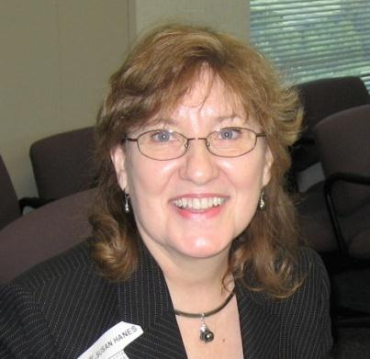
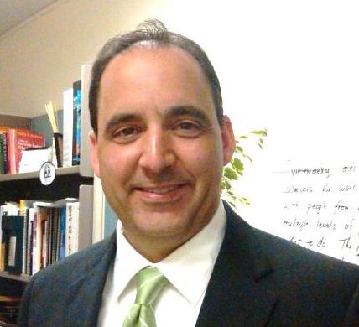
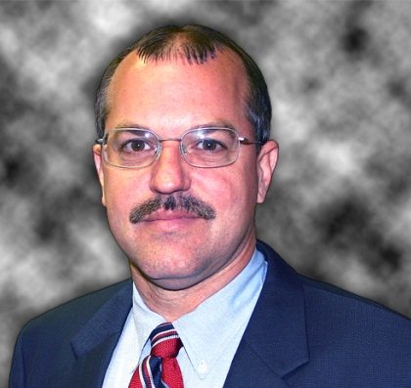
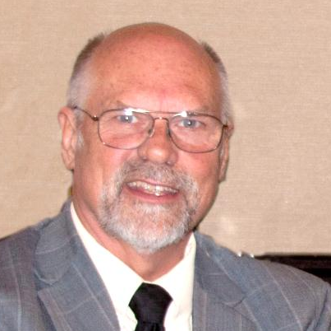


Panelists
Susan Hanes
NNSSIL Co-Coordinator/
Moderator
Mark Coscarella
Michigan DOE
Brian Staples
Douglass MS & HS, OK
Sam Redding
CII
Mary Colvin
OK DOE
Gina Scroggins
OK DOE
Notes:
15

Slide 16
For More Information www.centerii.org/leaders
Link to this webinar’s recording, slides and resources mentioned during the presentations
Feedback
Follow-up questions? Send to Susan Hanes, shanes@centerii.org

Slide 17

Thank you to our featured presenters and thank you all for participating in today’s webinar! Keep an eye out for our next webinar in April!
Notes:
17

